Slide 1
KPIs
KPIs

Slide 2
KPIs
Note: This workshop uses directly entered data
Date | Turnover | Objective
01/01/2025 | € | €10,000.00
01/02/2025 | €7,000.00 | €10,000.00
03/01/2025 | €9,500.00 | €10,000.00
04/01/2025 | €11,000.00 | €10,000.00

Slide 3
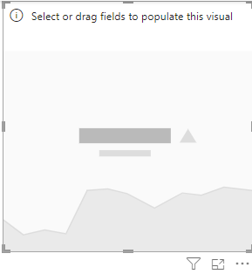
KPIs
KPI visual in the scene

Slide 4
KPIs
Import data
Load the Sales table into Power BI.
Make sure that the Date column is recognized as a date type field.
Add a KPI visual
In Power BI Desktop, click KPI in the visuals pane.
Drag Turnover into the Value field .
Drag Target into the Target Value field .
Drag Date into the Axis field to view the trend.
Value → Main indicator ( example : figure business current ).
Value target → Objective to be achieved .
Axis → Indicates the trend over time.
Colors → Green if the objective East reached , Yellow e if the result is neutral, red otherwise .

Slide 5
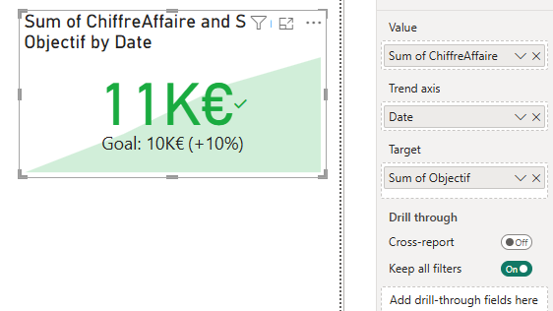
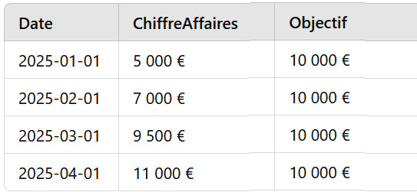
KPIs
Now we need to add the target. To do this, we need to create a metric that represents our goal.
Total Sum of the Figure Business = €32,500
Total amount of the Objective = €40,000
But Power BI takes uniquely in charge of the last one value ( €11,000 ) against €10,000

Slide 6
KPIs
Now we need to add the target. To do this, we need to create a metric that represents our goal.
Total Sum of the Figure Business = €32,500
Total amount of the Objective = €40,000
But Power BI takes uniquely in charge of the last one value ( €11,000 ) against €10,000

Slide 7
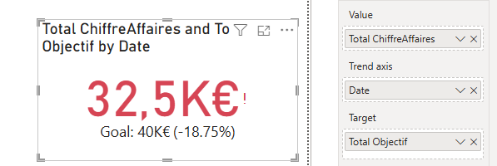
KPIs
It is also possible to take into consideration the sum, in this case it is necessary to create the aggregations
Total Sales = CALCULATE ( SUM ( SalesFact [ SalesFact ] ), ALL ( SalesFact ))
Total Target = CALCULATE ( SUM ( SalesFact [ Target ] ), ALL ( SalesFact ))

Slide 8
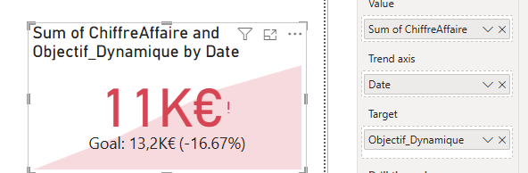
KPIs
It is also possible to calculate a dynamic objective
Dynamic_Objective = AVERAGE ( SalesFact [ Turnover ] ) * 1.2

Slide 9
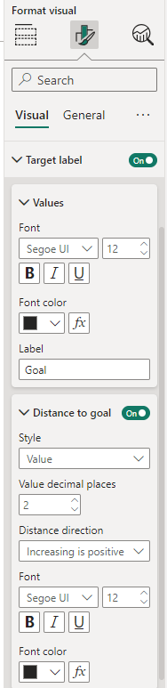
KPIs
Change the label value to be something other than a percentage

Slide 10
The personalized KPI

Slide 11
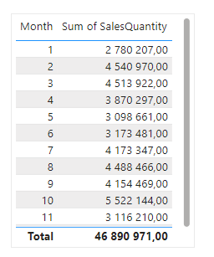
KPIs
Add a table visual with the Month field from DimDate and SalesQuantity from FactSales

Slide 12
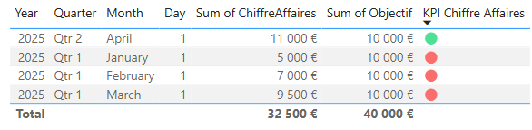
KPIs
Add a calculated column that returns a particular shape based on whether the goal was met or not
KPI Turnover = IF ( SalesFact [ Turnover ] > SalesFact [ Target ] , UNICHAR ( 128994 ), UNICHAR ( 128308 ))
The above measure compares the amount of Turnover to a target

Slide 13
KPIs
For more advanced alternatives to the standard KPI , here are some interesting visuals on AppSource :
"Advanced Card " → Allows you to display indicators with dynamic colors.
"Bullet Chart" → Compares an actual value to a target.
"Smart KPI List" ( OKViz ) → Displays multiple KPIs with color codes.
" Card with States" → Indicates whether the goal is achieved with colors.

Slide 14
Thank you
Thank you

